Slide 1


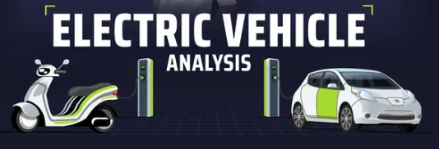
Human resources slide 1
Atliq Motors
Code Basics Project #12

Slide 2
Human resources slide 1
Content
Introduction
Problem Statement and Questions
Recommendations

Slide 3
Human resources slide 10
Atliq Motors
Introduction
ATLIQ Motors is an automotive giant from the USA specializing in electric vehicles (EV). In the last 5 years, their market share rose to 25% in electric and hybrid vehicles segment in North America. As a part of their expansion plans, they wanted to launch their bestselling models in India where their market share is less than 2%.

Slide 4
Human resources slide 10
Problem Statement
Atliq Motors
ATLIQ Motors is an automotive giant from the USA specializing in electric vehicles (EV). In the last 5 years, their market share rose to 25% in electric and hybrid vehicles segment in North America. As a part of their expansion plans, they wanted to launch their bestselling models in India where their market share is less than 2%.
As a Data Analyst, I have to get familiar with the data given and find the answers of the given questions. After that we need to drive insights to the stakeholders for clear decision making and expand the company in India effectively.

Slide 5
Human resources slide 2
Primary Analysis Questions
There are 10 Primary Analysis Questions given by Bruce Haryali, The chief of ATLIQ Motors to analyze the electric vehicle data from 2022 to 2024.

Slide 6
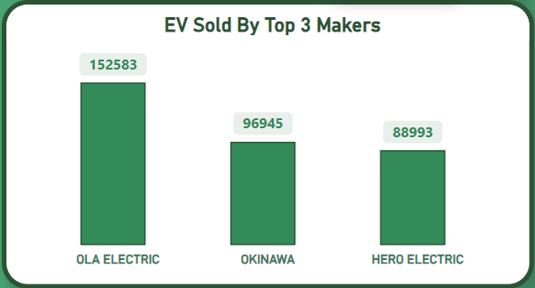
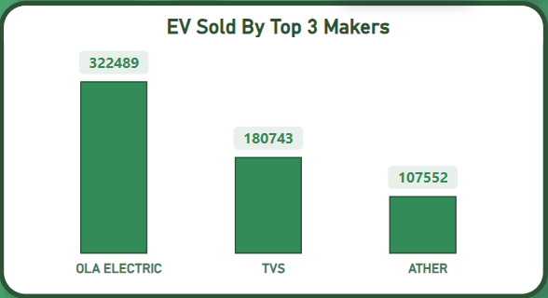
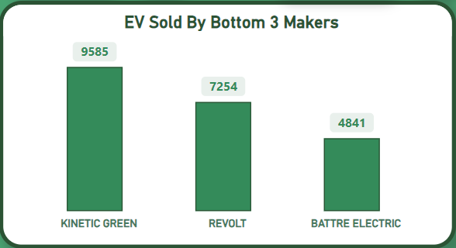
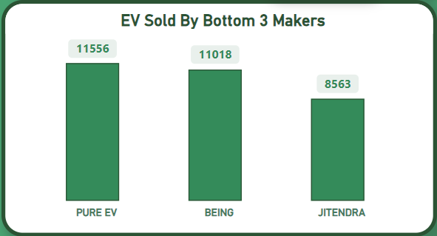
Human resources slide 2
1. List the top 3 and bottom 3 makers for the fiscal years 2023 and 2024 in terms of the number of 2-wheelers sold.
2023
2024

Slide 7
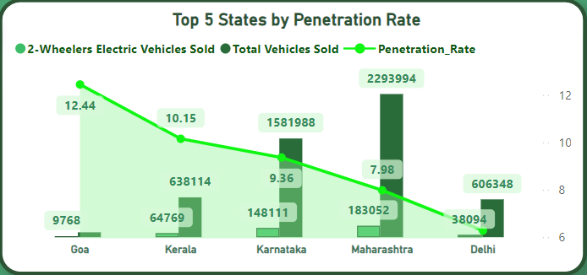
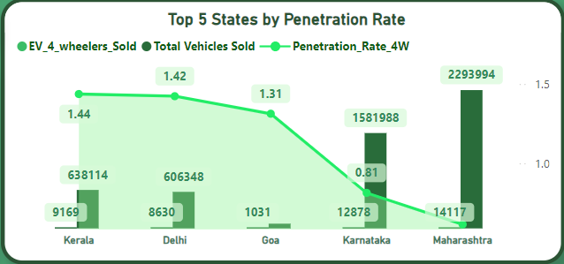
Human resources slide 2
2. Identify the top 5 states with the highest penetration rate in 2-wheeler and 4-wheeler EV sales in FY 2024.
2024
2024
2-Wheelers
4-Wheelers

Slide 8
Human resources slide 2
3. List the states with negative penetration (decline) in EV sales from 2022 to 2024?
There is not any state with the
negative penetration in EV sales from 2022 to 2024

Slide 9
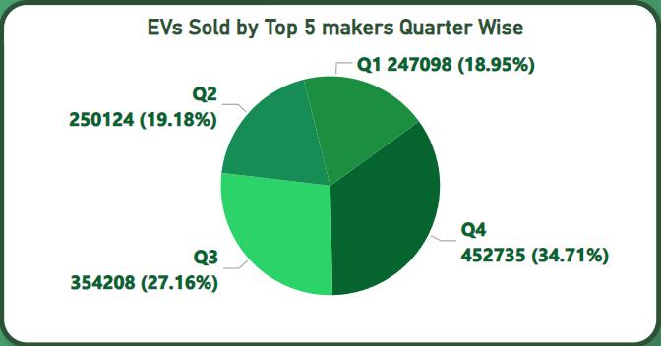
Human resources slide 2
4. What are the quarterly trends based on sales volume for the top 5 EV makers (4-wheelers) from 2022 to 2024?
Insight :- More than 34% of the EVs sold in the final Quarter of the financial Year

Slide 10
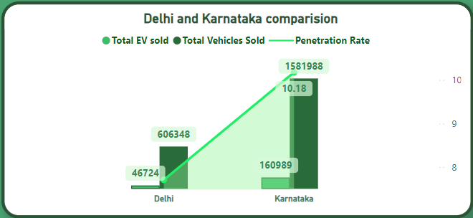
Human resources slide 2
5. How do the EV sales and penetration rates in Delhi compare to Karnataka for 2024?
Insight :- Karnataka has the higher penetration rate i.e. 10.18% compared to Delhi which has 7.71%. Karnataka has the upper hand in EV sales and penetration rate. Karnataka also offers better facilities to companies and people for promoting EVs.

Slide 11
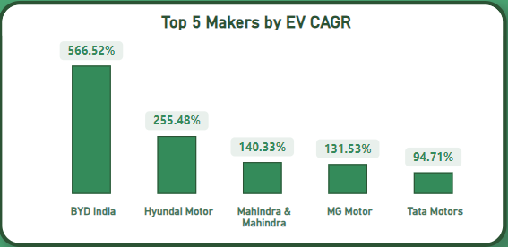
Human resources slide 2
6. List down the compounded annual growth rate (CAGR) in 4-wheeler units for the top 5 makers from 2022 to 2024.
Insight :- BYD India has grown explosively in 4-wheelers EV category which has grown
Over 500% in 2024 compared to 2022.

Slide 12
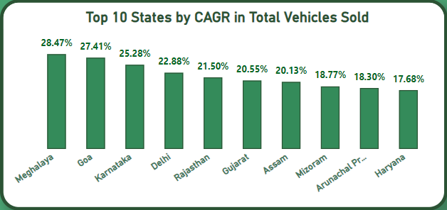
Human resources slide 2
7. List down the top 10 states that had the highest compounded annual growth rate (CAGR) from 2022 to 2024 in total vehicles sold.

Slide 13
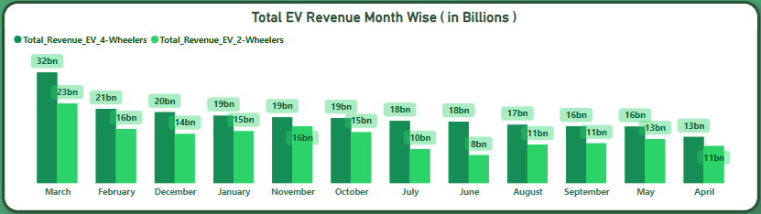
Human resources slide 2
8. What are the peak and low season months for EV sales based on the data from 2022 to 2024?
Insights :
4-Wheelers :- March is the highest sale month of the year while April is the lowest sale month.
2-Wheelers :- March is the highest sale month of the year while June is the lowest sale month.
Overall March and April are the peak and low season months for EV sales respectively.

Slide 14
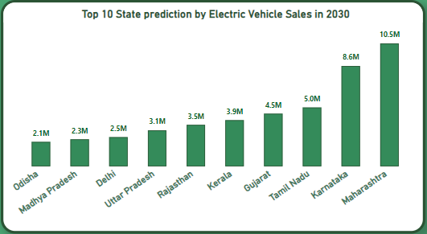
Human resources slide 2
9. What is the projected number of EV sales (including 2-wheelers and 4-wheelers) for the top 10 states by penetration rate in 2030, based on the compounded annual growth rate (CAGR) from previous years?
Insight :- Maharashtra and Karnataka has the highest potential in the near future
for the Electric Vehicle sales in India.

Slide 15
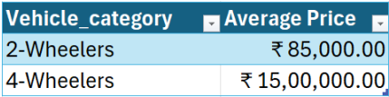
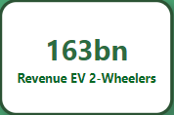
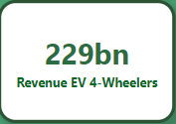
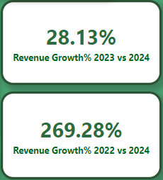
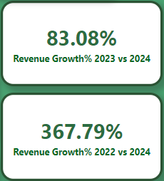
Human resources slide 2
10. Estimate the revenue growth rate of 4-wheeler and 2-wheelers EVs in India for 2022 vs 2024 and 2023 vs 2024, assuming an average unit price.

Slide 16
Human resources slide 2
Secondary Analysis
Questions

Slide 17
Human resources slide 10
1. What are the primary reasons for customers choosing 4-wheeler EVs in 2023 and 2024?
Technology and
Infrastructure
improvement
Environmental
Concerns
Govt. incentives
And subsidies
Lower Cost of Ownership
25%
30%
25%
20%
The enhancement in battery technology leading to longer driving ranges, faster charging times, and better overall performance is making EVs a more practical choice for consumers.
Increasing awareness about climate change and the desire to reduce carbon footprints are driving many consumers to opt for environmentally friendly EVs.
EVs typically have lower maintenance costs and fuel expenses, which is a significant factor for customers looking for long-term savings.
Financial incentives like tax rebates, subsidies, and reduced registration fees are making EVs more affordable and attractive to buyers.

Slide 18
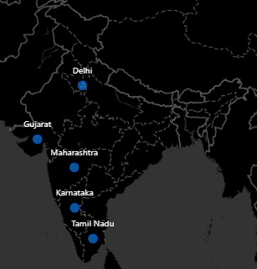
Human resources slide 5
2. How do government incentives and subsidies impact
the adoption rates of 2-wheelers and 4-wheelers?
Which states in India provided the most subsidies?
Impact on Adoption Rates: Government incentives and subsidies significantly boost the adoption rates of both 2-wheelers and 4-wheelers by lowering the purchase cost, making EVs more financially accessible to a larger population.
States Providing the Most Subsidies: States like Maharashtra, Delhi, Gujarat, Tamil Nadu, and Karnataka have been proactive in offering substantial subsidies for EV purchases. These states also provide benefits like reduced road tax, registration fees, and even free charging in certain locations.

Slide 19

Human resources slide 8
3. How does the availability of charging stations infrastructure correlate with EV sales and penetration rates in the top 5 states?
Correlation Analysis: The availability of charging infrastructure is directly correlated with higher EV sales and penetration rates. States with a well-established network of charging stations see higher adoption rates because they reduce range anxiety and provide convenience for daily and long-distance travel.
Maharashtra: High correlation due to extensive charging infrastructure in urban centers.
Delhi: Strong correlation with numerous public and private charging stations.
Gujarat: Increasing correlation as the state rapidly expands its charging network.
Tamil Nadu: Positive correlation, especially in metropolitan areas like Chennai.
Karnataka: Significant correlation, particularly in Bangalore, a tech hub with high EV adoption.

Slide 20
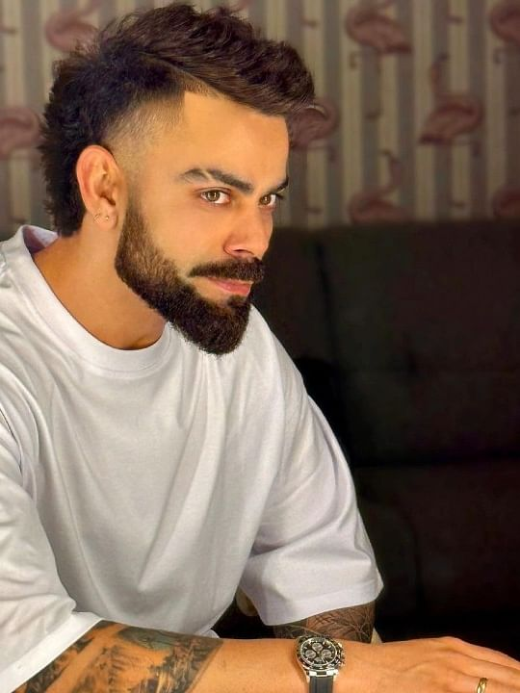
Human resources slide 8
4. Who should be the brand ambassador if AtliQ Motors launches their EV/Hybrid vehicles in India and why?
Potential Brand Ambassadors:
Virat Kohli: A popular and influential figure in India, known for his fitness and active lifestyle, which aligns well with the green and dynamic image of EVs.
Akshay Kumar: Known for his discipline and responsible image, which resonates with the eco-conscious message of EVs.
Why: Choosing a brand ambassador like Virat Kohli can help ATLIQ Motors connect with both younger and environmentally-conscious audiences, while Akshay Kumar’s appeal across diverse demographics can enhance brand credibility and reach.

Slide 21
Human resources slide 8
5. Which state of India is ideal to start the manufacturing unit? (Based on subsidies provided, ease of doing business, stability in governance etc.)
Ideal State: Maharashtra
Subsidies: Offers significant financial incentives for setting up EV manufacturing units, including capital subsidies and tax benefits.
Ease of Doing Business: Consistently ranked high in ease of doing business with well-developed infrastructure and logistics support.
Governance Stability: Strong governance and clear policy framework make it a reliable choice for long-term investments.

Slide 22
Human resources slide 9
My Top 3 Recommendations to AtliQ Motors
Major Focus on these 3 states
Maharashtra
Karnataka
Tamil Nadu
Maharashtra is the ideal state to start manufacturing because of the facilities provided by the Govt. It is also the largest vehicle consumer state in India.
It can be very impactful to run more campaigns and advertisements
in the last quarter(Q4) of the financial year. As it can be seen from the
analysis, more than 34% revenue came from the Quarter 4.
I would like to recommend that company should Launch models in the mid-range segment (both in terms of pricing and range) to capture the largest customer base and make EVs accessible to a broader audience with strong branding and marketing efforts, highlighting the eco-friendly aspects of EVs, and leverage influential brand ambassadors to create a strong brand identity.

Slide 23
Human resources slide 8
Atliq Motors
THANK YOU!!
Made by Paras Jain

